Slide 1

APEX INSTITUTE OF TECHNOLOGY
DEPARTMENT OF COMPUTER SCIENCE & ENGINEERING
Computer Organization & Architecture (21CSH-281)
Faculty: Siddharth Kumar (E12853)
Lecture - 14
Computer Arithmetic: Carry Save Multiplier, Division restoring and non-restoring techniques
DISCOVER . LEARN . EMPOWER

Slide 2
Computer Organization & Architecture: Course Objectives
COURSE OBJECTIVES
The course aims to:
The purpose of the course is to introduce principles of computer organization and the basic architectural concepts.
It begins with basic organization, design, and programming of a simple digital computer and introduces simple register transfer language to specify various computer operations.
Topics include computer arithmetic, instruction set design, microprogrammed control unit, pipelining and vector processing, memory organization and I/O systems, and multiprocessors.
To familiarize Students with the detailed Architectures of a Central Processing Unit.
Learn the different types of serial communication techniques.

Slide 3
COURSE OUTCOMES
On completion of this course, the students shall be able to:-
CO1 | Identify and interpret the basics of instruction sets and their impact on the design, organization, and functionality of various functional units of a computer comparable to the CPU, memory organization, I/O organization, and parallel processors.
CO2 | Analysis of the design of arithmetic & logic unit and understanding of the fixed point and floating-point arithmetic operations.
CO3 | Relate cost performance and design trade-offs in designing and constructing a computer processor which includes memory.
CO4 | Understanding the different ways of communicating with I/O devices and standard I/O interfaces.
CO5 | Implementation of control unit techniques and the concept of Pipelining.

Slide 4
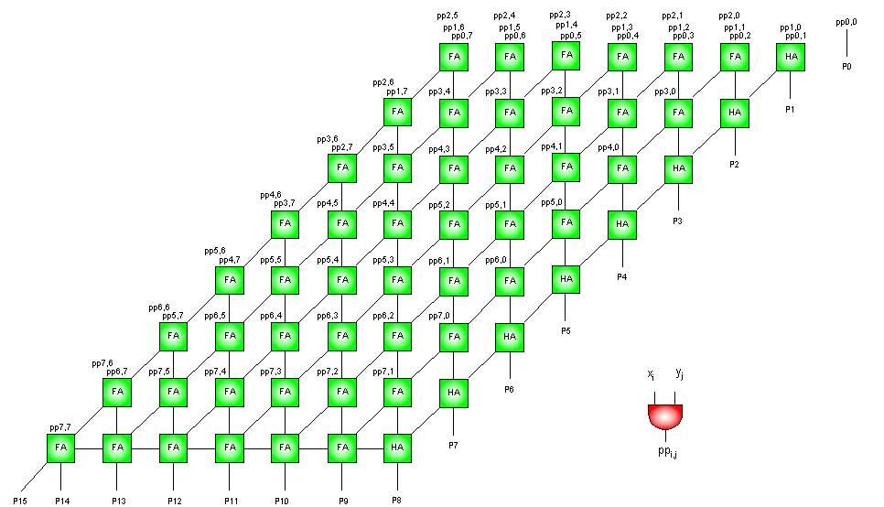
Carry Save Multiplier
Description: A parallel multiplier for unsigned operands. It is composed of 2-input AND gates for producing the partial products, a series of carry save adders for adding them and a ripple-carry adder for producing the final product.
Supported Sizes: 2, 3, 4, ..., 255, 256
Supported Languages: VHDL, Verilog
Example: An 8-bit Carry Save Multiplier
Figure: Carry Save Multiplier

Slide 5
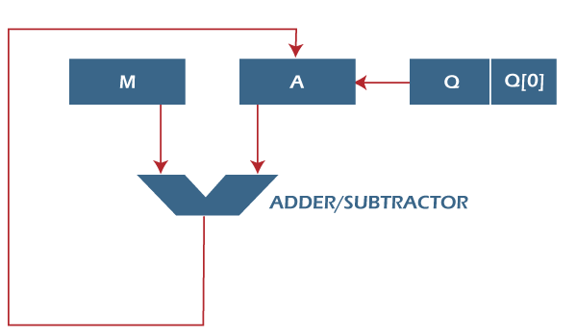
Restoring Division Algorithm for Unsigned Integer
Restoring division is usually performed on the fixed point fractional numbers. When we perform division operations on two numbers, the division algorithm will give us two things, i.e., quotient and remainder. This algorithm is based on the assumption that 0 < D < N. With the help of digit set {0, 1}, the quotient digit q will be formed in the restoring division algorithm. The division algorithm is generally of two types, i.e., fast algorithm and slow algorithm. Goldschmidt and Newton-Raphson are the types of fast division algorithm, and (String Data Structure) STR algorithm, restoring algorithm, non-performing algorithm, and the non-restoring algorithm are the types of slow division algorithm.
In this page, we are going to perform restoring algorithm with the help of an unsigned integer.
We are using restoring term because we know that the value of register A will be restored after each iteration.
We will also try to solve this problem using the flow chart and apply bit operations.
Figure: Restoring Division Algorithm

Slide 6
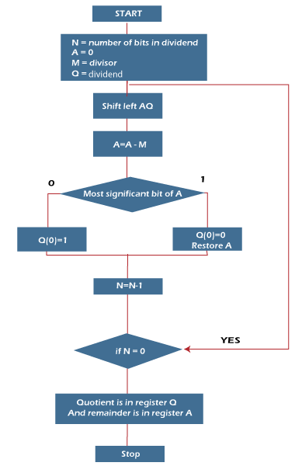
Here, register Q is used to contain the quotient, and register A is used to contain the remainder. Here, the divisor will be loaded into the register M, and n-bit divided will be loaded into the register Q. 0 is the starting value of a register. The values of these types of registers are restored at the time of iteration. That's why it is known as restoring.
Now we will learn some steps of restoring division algorithm, which is described as follows:
Step 1: In this step, the corresponding value will be initialized to the registers, i.e., register A will contain value 0, register M will contain Divisor, register Q will contain Dividend, and N is used to specify the number of bits in dividend.
Step 2: In this step, register A and register Q will be treated as a single unit, and the value of both the registers will be shifted left.
Figure: Flowchart

Slide 7
Step 3: After that, the value of register M will be subtracted from register A. The result of subtraction will be stored in register A.
Step 4: Now, check the most significant bit of register A. If this bit of register A is 0, then the least significant bit of register Q will be set with a value 1. If the most significant bit of A is 1, then the least significant bit of register Q will be set to with value 0, and restore the value of A that means it will restore the value of register A before subtraction with M.
Step 5: After that, the value of N will be decremented. Here n is used as a counter.
Step 6: Now, if the value of N is 0, we will break the loop. Otherwise, we have to again go to step 2.
Step 7: This is the last step. In this step, the quotient is contained in the register Q, and the remainder is contained in register A.
For example: In this example, we will perform a Division restoring algorithm.
Dividend = 11
Divisor = 3

Slide 8
N | M | A | Q | Operation
4 | 00011 | 00000 | 1011 | Initialize
 | 00011 | 00001 | 011_ | Shift left AQ
 | 00011 | 11110 | 011_ | A = A - M
 | 00011 | 00001 | 0110 | Q[0] = 0 And restore A
3 | 00011 | 00010 | 110_ | Shift left AQ
 | 00011 | 11111 | 110_ | A = A - M
 | 00011 | 00010 | 1100 | Q[0] = 0
2 | 00011 | 00101 | 100_ | Shift left AQ
 | 00011 | 00010 | 100_ | A = A - M
 | 00011 | 00010 | 1001 | Q[0] = 1
1 | 00011 | 00101 | 001_ | Shift left AQ
 | 00011 | 00010 | 001_ | A = A - M
 | 00011 | 00010 | 0011 | Q[0] = 1
So we should not forget to restore the value of the most significant bit of A, which is 1. So, register A contains the remainder 2, and register Q contains the quotient 3.

Slide 9
Non-Restoring Division Algorithm for Unsigned Integer
In earlier post Restoring Division learned about restoring division. Now, here perform Non-Restoring division, it is less complex than the restoring one because simpler operation are involved i.e. addition and subtraction, also now restoring step is performed. Instead of the quotient digit set {0, 1}, the set {-1, 1} is used by the non-restoring division.
The non-restoring division algorithm is more complex as compared to the restoring division algorithm.
But when we implement this algorithm in hardware, it has an advantage, i.e., it contains only one decision and addition/subtraction per quotient bit.
After performing the subtraction operation, there will not be any restoring steps.
Due to this, the numbers of operations basically cut down up to half.
Because of the less operation, the execution of this algorithm will be fast.
This algorithm basically performs simple operations such as addition, subtraction.
In this method, we will use the sign bit of register A. 0 is the starting value/bit of register A.

Slide 10
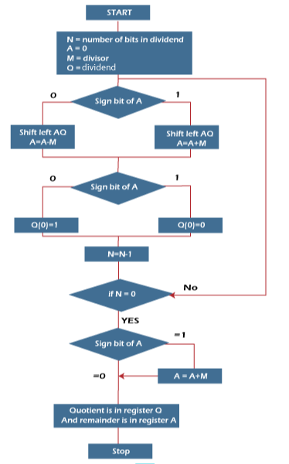
Now we will learn steps of the non-restoring division algorithm, which are described as follows:
Step 1: In this step, the corresponding value will be initialized to the registers, i.e., register A will contain value 0, register M will contain Divisor, register Q will contain Dividend, and N is used to specify the number of bits in dividend.
Step 2: In this step, we will check the sign bit of A.
Step 3: If this bit of register A is 1, then shift the value of AQ through left, and perform A = A + M. If this bit is 0, then shift the value of AQ into left and perform A = A - M. That means in case of 0, the 2's complement of M is added into register A, and the result is stored into A.
Step 4: Now, we will check the sign bit of A again.
Figure: Flowchart

Slide 11
Step 5: If this bit of register A is 1, then Q[0] will become 0. If this bit is 0, then Q[0] will become 1. Here Q[0] indicates the least significant bit of Q.
Step 6: After that, the value of N will be decremented. Here N is used as a counter.
Step 7: If the value of N = 0, then we will go to the next step. Otherwise, we have to again go to step 2.
Step 8: We will perform A = A + M if the sign bit of register A is 1.
Step 9: This is the last step. In this step, register A contains the remainder, and register Q contains the quotient.
For example: In this example, we will perform a Non-Restoring Division algorithm with the help of an Unsigned integer.
Dividend = 11
Divisor = 3
-M = 11101

Slide 12
N | M | A | Q | Action
4 | 00011 | 00000 | 1011 | Begin
 | 00011 | 00001 | 011_ | Shift left AQ
 | 00011 | 11110 | 011_ | A = A - M
3 | 00011 | 11110 | 0110 | Q[0] = 0
 | 00011 | 11100 | 110_ | Shift left AQ
 | 00011 | 11111 | 110_ | A = A + M
2 | 00011 | 11111 | 1100 | Q[0] = 0
 | 00011 | 11111 | 100_ | Shift left AQ
 | 00011 | 00010 | 100_ | A = A +M
1 | 00011 | 00010 | 1001 | Q[0] = 1
 | 00011 | 00101 | 001_ | Shift left AQ
 | 00011 | 00010 | 001_ | A = A - M
0 | 00011 | 00010 | 0011 | Q[0] = 1
So, register A contains the remainder 2, and register Q contains the quotient 3.

Slide 13
Summary
Discussed about Restoring Division Algorithm for Unsigned Integer.
Discussed about Non-Restoring Division Algorithm for Unsigned Integer.
Discussed the working mechanism of Carry Save Multiplier.
Assessment Questions
Q1. The twos complement integer division algorithm is known as the restoring method because the value in the A register must be restored following unsuccessful subtraction. A slightly more complex approach, known as no restoring, avoids the unnecessary subtraction and addition. Propose an algorithm for this latter approach.

Slide 14
THANK YOU

